Slide 1
The price effects of cross-market mergers: Theory and evidence from the hospital industry
Dafny, Ho, and Lee (2019)
Presented by Martha Wetzel

Slide 2
Background
Within-market hospital mergers have been shown to increase prices without changing quality
FTC has successfully challenged some proposed within-market hospital mergers
What about hospital mergers across distinct geographic markets?
More than half of the 528 general acute-care hospital mergers between 2000 and 2012 did not have an overlapping geographical market
FTC has not challenged these types of mergers

Slide 3
Research Question
“Evaluate mergers of upstream suppliers to intermediaries that bundle products or services for sale to customers, who in turn may aggregate the preferences of multiple individuals”
Develop a formal theory demonstrating the effect of these type of merges on prices
Empirically test predictions from their theory

Slide 4
Motivating Example
Imagine a statewide employer with employees scattered across 10 local markets
Imagine each local market has 3 hospitals
If a potential health plan didn’t cover one of the hospitals in the state, the employer probably won’t care
But, what if one hospital from each region merged to create a hospital network?
Would likely not be blocked by anti-trust action because the hospitals cover distinct geographic regions
If an insurer didn’t contract with that hospital network, thus losing a third of all hospitals in the state, the employer might drop them

Slide 5
Findings Preview
Hospitals in the network of an acquirer that are within the same state as the newly acquired hospital have a 7-10% relative price increase compared to controls
Notes:
(i) hospitals acquiring a
new system member in the same state but not the same narrow geographic market (“adjacent
treatment hospitals”); (ii) hospitals acquiring a new system member out-of-state (“nonadjacent
treatment hospitals”); and (iii) hospitals that are not members of “target” (i.e., acquired) or
acquiring systems.

Slide 6
Theoretical Model
Consider two hospitals bargaining with a common insurer
Hospitals are upstream suppliers
Insurer is a downstream intermediary
Hospitals bargain separately if they are independent; a bargaining fail removes the hospital from the insurer’s network
Hospitals bargain together if they merged; a bargaining fail removes both hospitals from the insurer’s network
Market power effect: “an outcome where the merged hospitals are able to negotiate higher reimbursement prices without an increase in quality or bargaining effectiveness”
This happens if the combined contribution to the insurer’s profits is greater than the sum of the individual hospital’s contributions to the insurers
Whether this holds depends on whether the insurer’s objective function is separable across markets (i.e., no common customers)

Slide 7
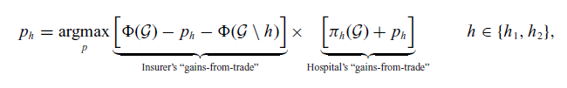
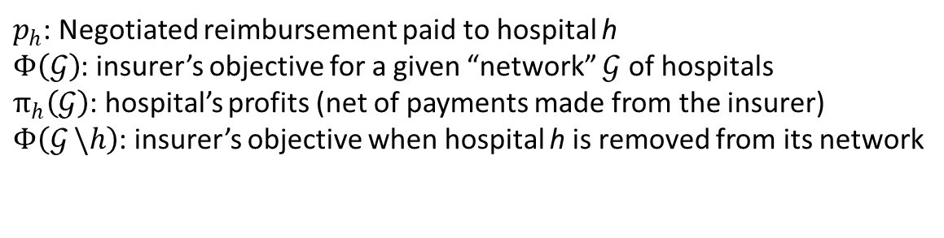
Theoretical Model, Math Edition
Basic model, pre-merger: each hospital engages in a bilateral Nash bargain with the insurer
$p_{h}$: Negotiated reimbursement paid to hospital h
$Φ\left(𝒢\right)$: insurer’s objective for a given “network” $𝒢$ of hospitals
$π_{h}\left(𝒢\right)$: hospital’s profits (net of payments made from the insurer)
$Φ\left(𝒢 \backslash h\right)$: insurer’s objective when hospital h is removed from its network

Slide 8
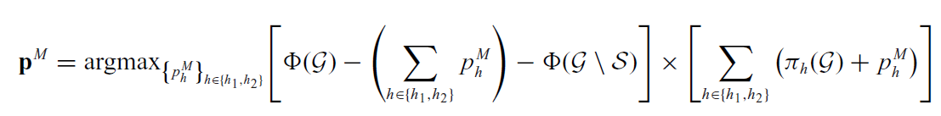
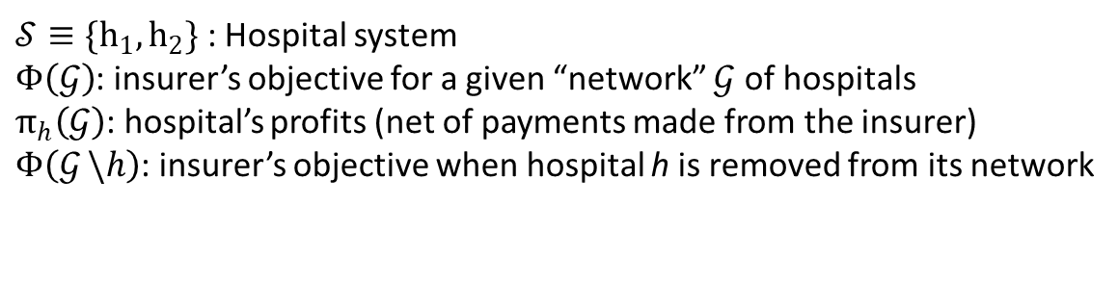
Theoretical Model, Math Edition
Post-merger: merged hospitals bargain together
$𝒮≡{\{h}_{1},h_{2}\}$ : Hospital system
$Φ\left(𝒢\right)$: insurer’s objective for a given “network” $𝒢$ of hospitals
$π_{h}\left(𝒢\right)$: hospital’s profits (net of payments made from the insurer)
$Φ\left(𝒢 \backslash h\right)$: insurer’s objective when hospital h is removed from its network

Slide 9

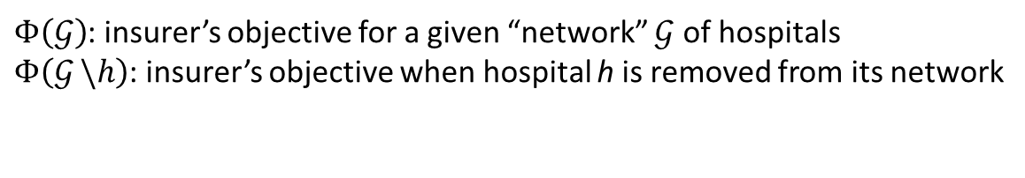
Theoretical Model: FOC
Comparison of the first order conditions for the pre-merger and post-merger prices yields the condition under which a merger will increase prices:
$Φ\left(𝒢\right)$: insurer’s objective for a given “network” $𝒢$ of hospitals
$Φ\left(𝒢 \backslash h\right)$: insurer’s objective when hospital h is removed from its network
Meaning: “payments will increase if the reduction in an insurer’s objective function from losing the system exceeds the sum of the reductions from losing each hospital separately.”
Notes:
“A sufficient condition for (6) to hold, and for a merger to increase negotiated payments, is
for the insurer’s objective to be strictly submodular in its network of hospitals: that is, the value
of each hospital to the insurer is lower when the insurer’s network is larger (e.g., when the other
hospital is on the network than when the other hospital is removed), which is typically satisfied
when hospitals are substitutable for one another.12 We refer to such a merger as one that increases
the hospitals’ bargaining leverage.”

Slide 10
Testable Predictions
Existence of common insurers that operate in the markets of both the acquiring and the target hospital
More common customers leads to a larger price effect
Expect out-of-state mergers to have less of an effect than within state mergers
The price effect will increase based on the size of the target

Slide 11
Competing Hypotheses
Cost efficiencies
Common insurer effects without common customers
Hospital investment in assets or quality
Transferable bargaining weight or negotiating skill
Market definition

Slide 12
Identification: Endogeneity
The challenge: “identifying a set of hospitals whose involvement in a cross-market merger is plausibly exogenous to other determinants of hospital prices”
Conceptual solution: focus on “bystander” hospitals, meaning those that happen to be part of the acquiring hospital network but are not the driver of the transaction
Implementation: Drop hospitals in overlapping geographic markets or the largest hospital(s) of the target system

Slide 13
Samples
FTC sample
Mergers investigated by the FTC due to geographic overlap between the merging parties, but ended up taking place
Years 1996–2011
N=20
Broad sample
All acquisitions and mergers involving general acute-care hospitals during 2002–2012
Proprietary reports assembled by Irving Levin Associates
Exclude mergers between independent hospitals
Drop the “crown jewels” of each transaction
Largest hospital(s) being acquired
Drop hospitals gaining a system member within a 30 minute drive

Slide 14
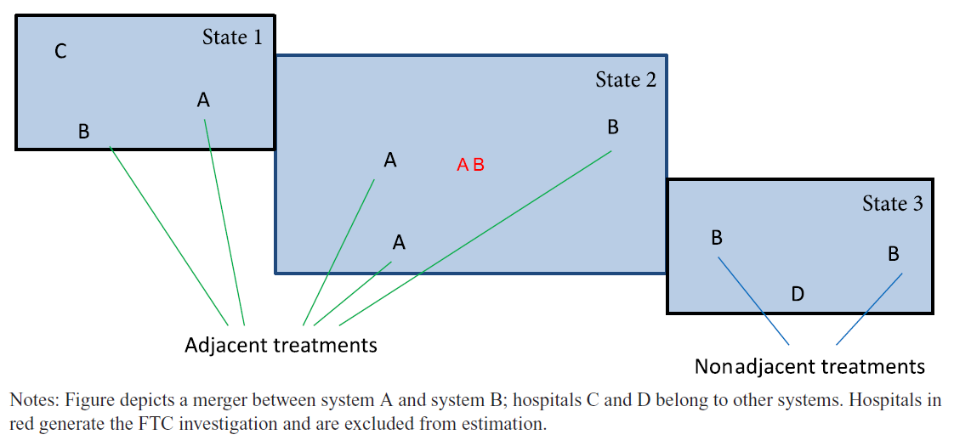
Sample Illustration

Slide 15
Data
Healthcare Cost Report Information System (HCRIS) for fiscal years 1996-2012
Estimate price for a standardized inpatient admission by dividing the net inpatient revenue for non-Medicare patients by the total number of non-Medicare inpatients, controlling for Medicare case-mix index

Slide 16
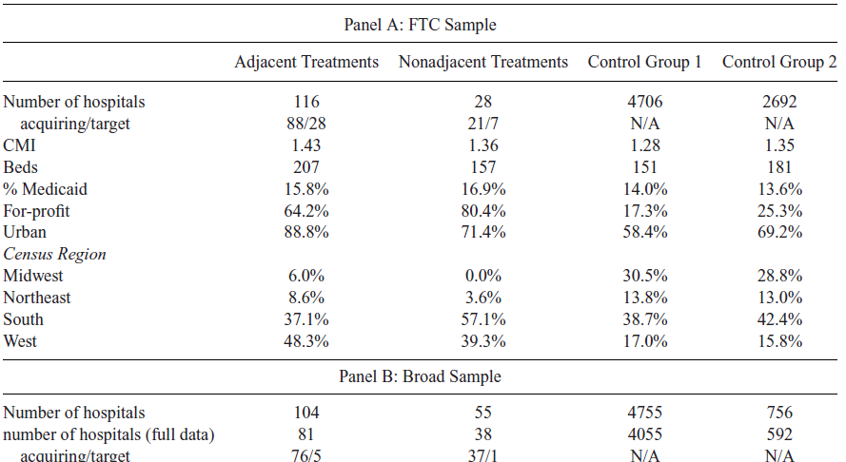
Descriptive Stats
Notes:
“Control Group 1 consists of all hospitals not excluded due to same-market overlap (and
not classified as treatments). Control Group 2 reflects the further restriction that control hospitals
should be members of systems, and in the case of the broad sample, that they not be located
within 30 minutes of a treated hospital”

Slide 17

Analysis
Difference in difference: Event study with 2-way fixed effects
Unit of analysis: hospital-year
Observations are weighted hospital’s average number of discharges
Standard errors clustered by hospital

Slide 18
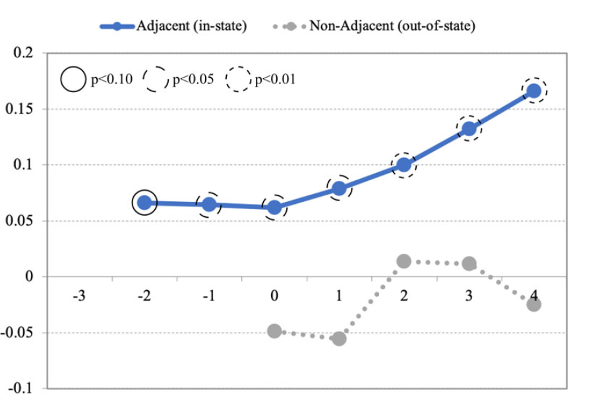
Results: FTC Sample

Slide 19
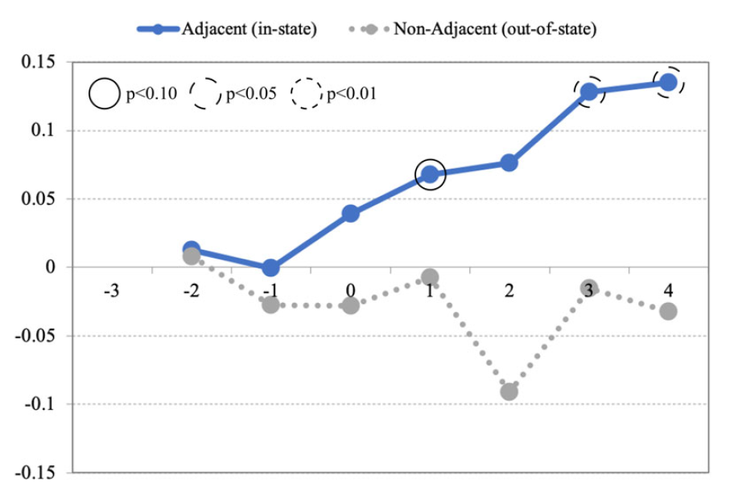
Results: Broad Sample

Slide 20
Predictions
Prediction
Finding
Existence of common insurers that operate in the markets of both the acquiring and the target hospital
More common customers leads to a larger price effect
Expect out-of-state mergers to have less of an effect than within state mergers
The price effect will increase based on the size of the target
Measured insurance overlap at the CBSA-level in 2012; coefficients positive but noisy
No effect for out-of-state treated hospitals. The effect is stronger in hospitals 30-90 minutes apart than for those >90 minutes away
Small acquirers raise prices more after acquiring a larger target (compared to a small target)

Slide 21
Alternative Explanation
What if these are actually horizontal, as opposed to cross-market, mergers?
Broader “same-market” definition: 45 minutes instead of 30
Drops a substantial portion of the treatment hospitals
Effect is of similar magnitude but imprecisely measured
Analyze same-market hospitals
Hospitals within 30 minutes were dropped from main analysis
Price effect is small and indistinguishable from 0

Slide 22
Discussion
Threats: Endogeneity

Slide 23
Discussion
“The evidence for market-based learning implies that the effect of report cards is typically overestimated.”

